Slide 1

Retail-customer segmentation and churn prediction
Ujwal Kesharwani
Shivani Kadam
Amrin Mohammed

Slide 2
Problem Statement
Retailkart.com, a small and medium-sized organisation, is finding it difficult to remain competitive in the market due to increased competition from companies offering quick and free online delivery. Customer behaviour is changing, with more customers preferring online quick delivery for their daily necessities. To provide a data-driven strategy to reducing marketing conundrums through customer segmentation, identify the group of customers most likely to churn, and create successful marketing programmes based on customer qualities to keep them from leaving the platform. This could include collecting customer data, doing trials, and using consumer preferences and behaviour to execute targeted customer retention initiatives.

Slide 3
BUSINESS OBJECTIVES
With increased competition promising 10-minute delivery, among other benefits, the company's near-term goal is to preserve its overall market share.
However, it has become crucial for the corporation to maintain existing consumers and promote platform expansion.
Increase conversion rates and buy frequency for current offline clients by shifting them to the online realm and providing a more personalised experience can boost platform growth.
More than six months after introducing the platform online, the company is attempting to come up with better ways to keep existing clients and prevent them from opting out.

Slide 4
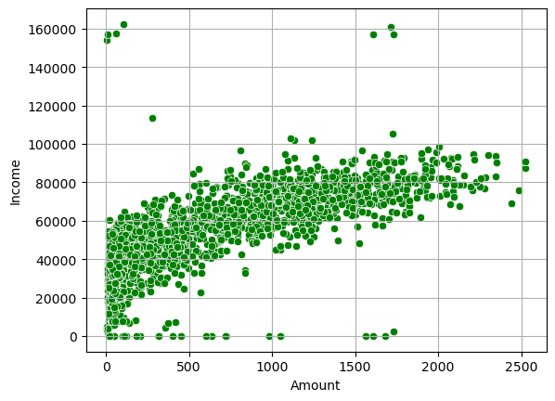
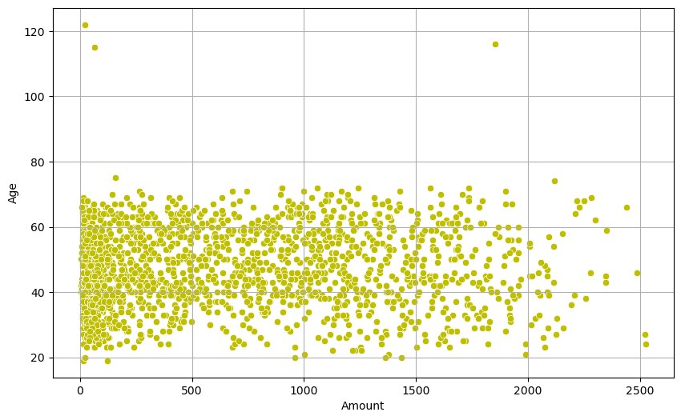
Part- I : Customer SEGMENTATION eda

Slide 5
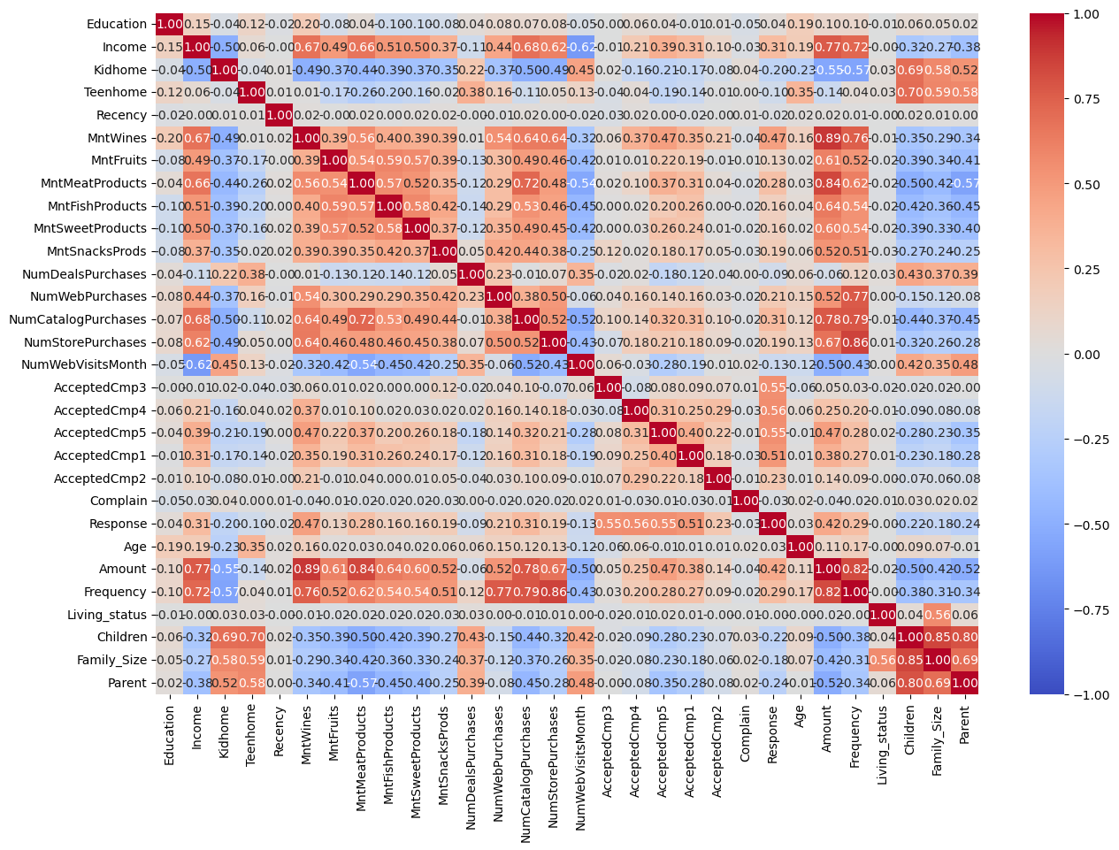

Slide 6
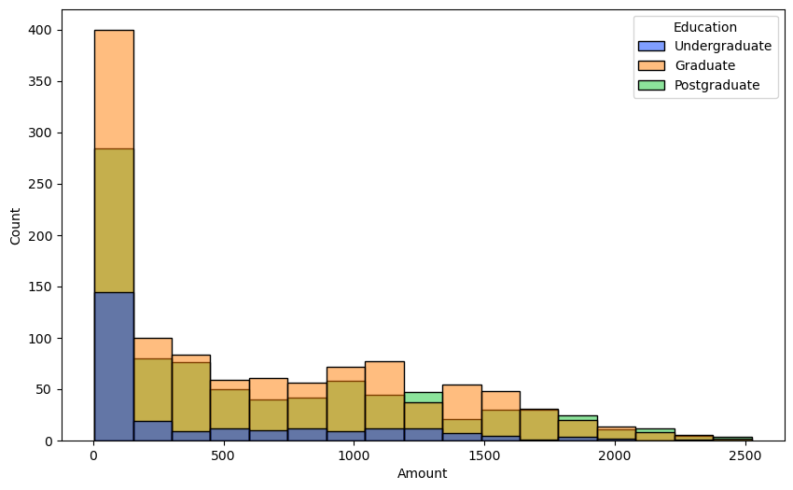
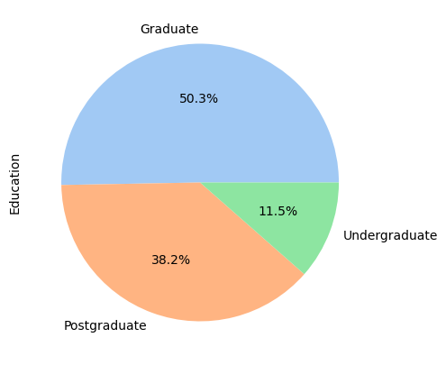

Slide 7
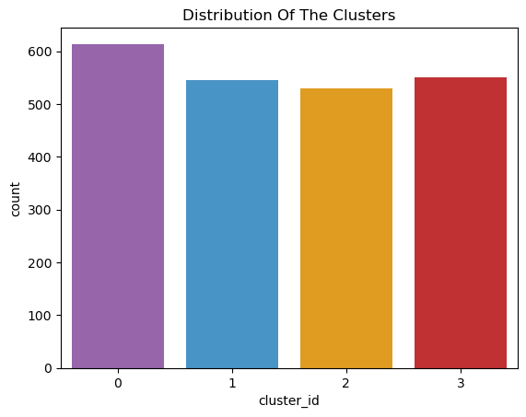
Cluster Analysis

Slide 8
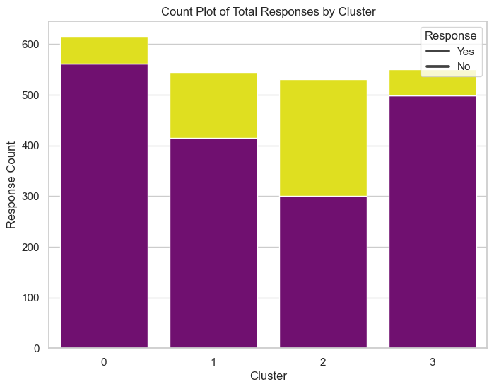
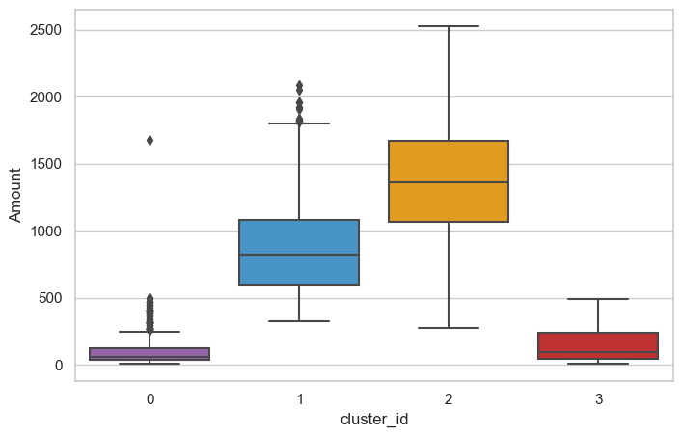

Slide 9
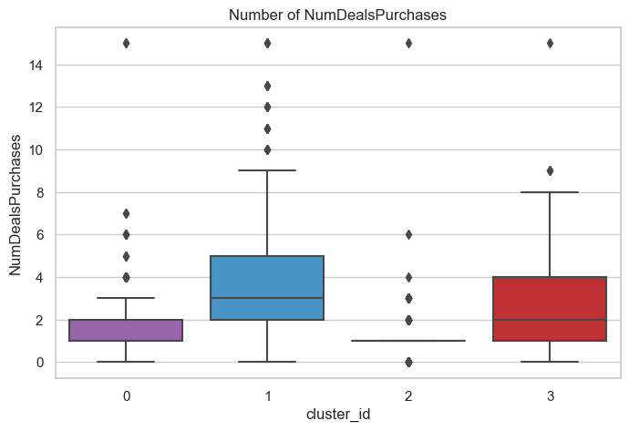
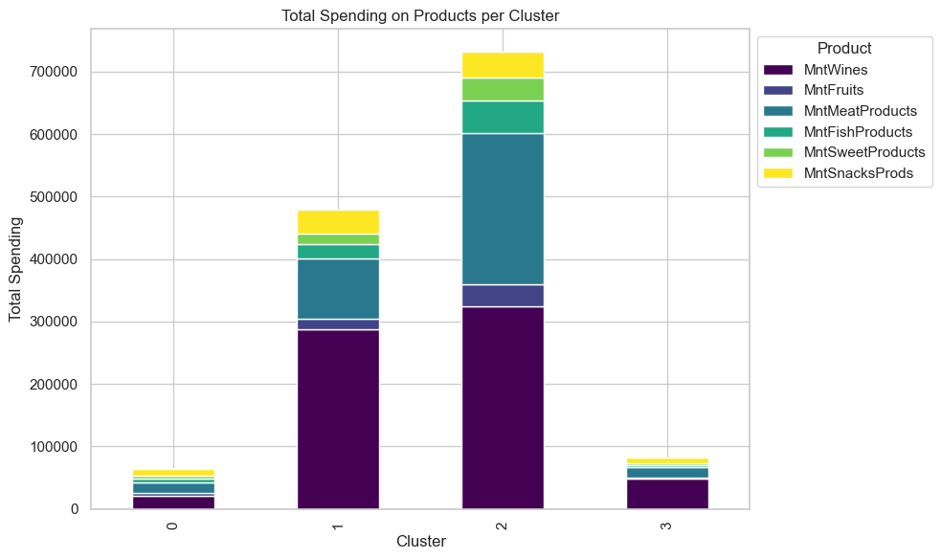

Slide 10
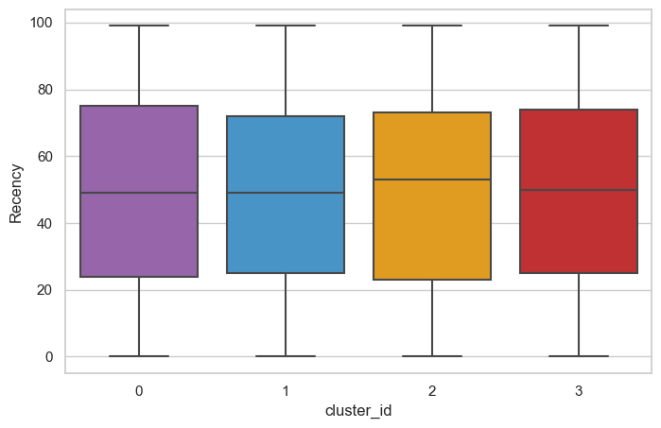
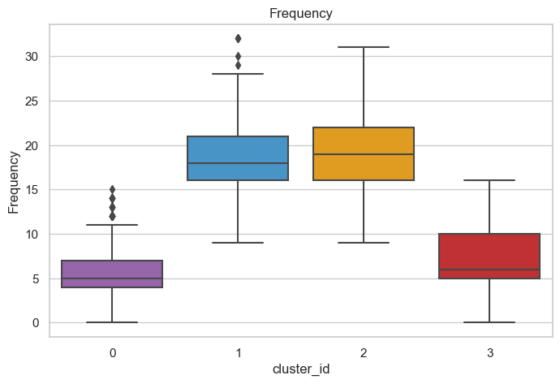

Slide 11
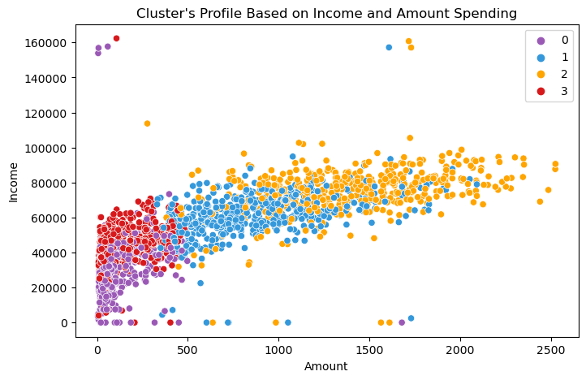
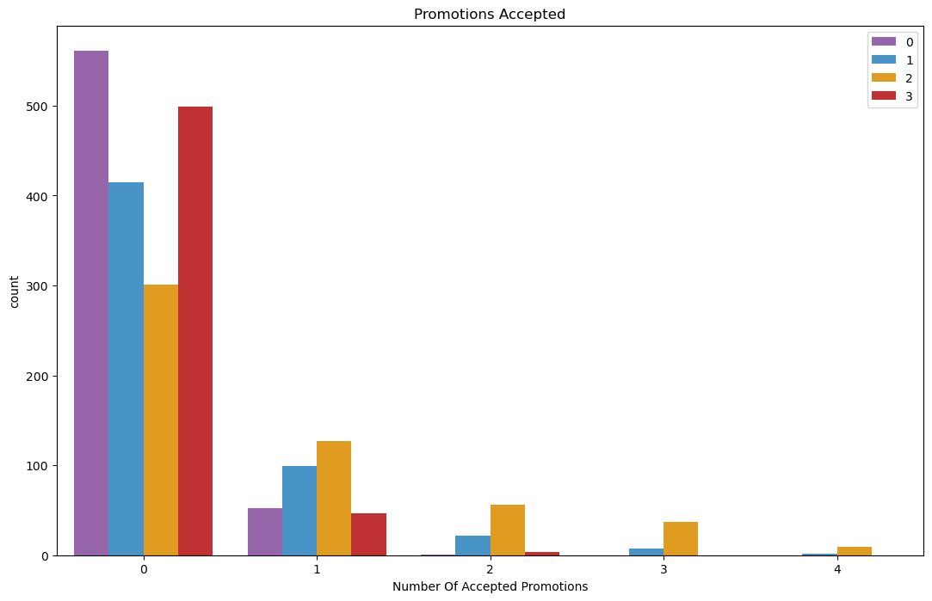

Slide 12
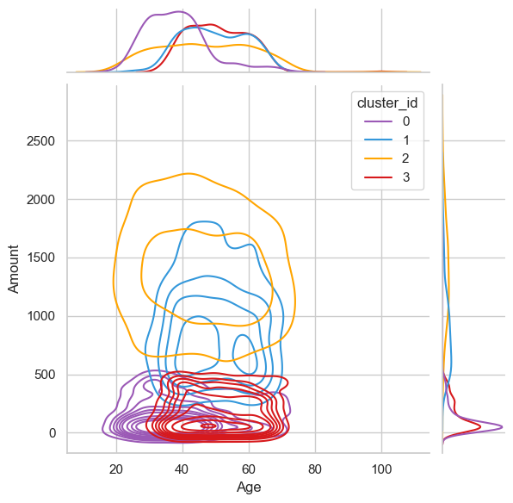
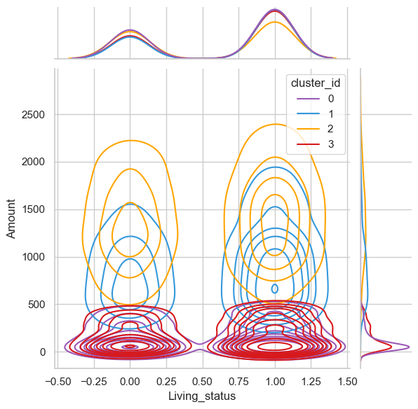
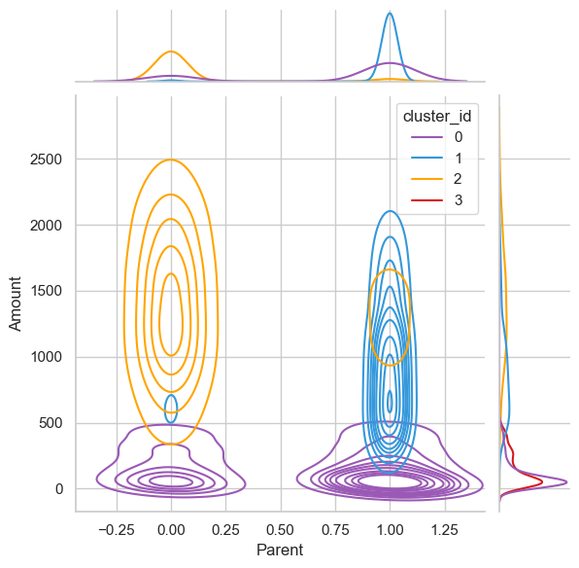

Slide 13
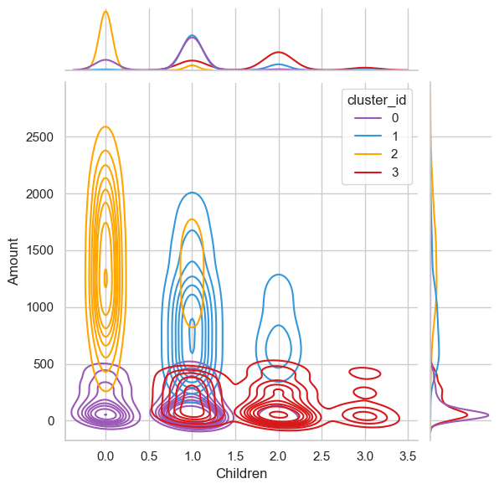
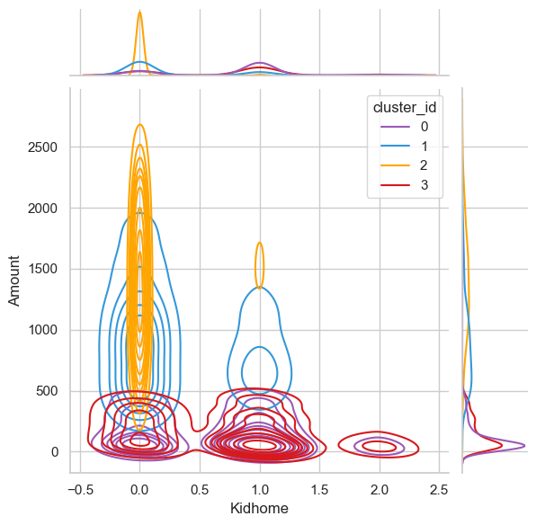
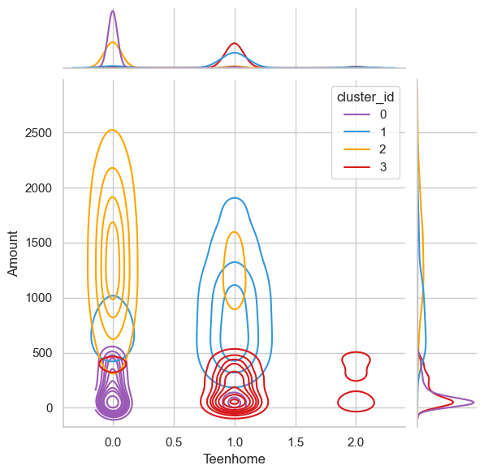

Slide 14
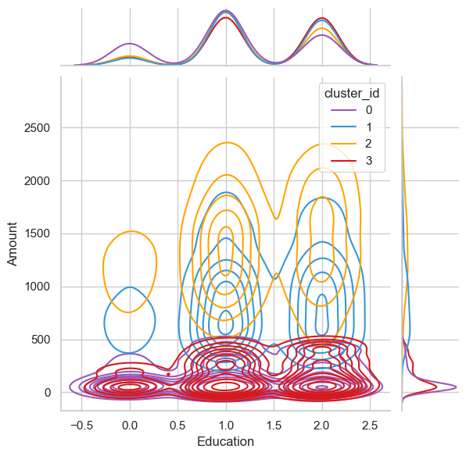
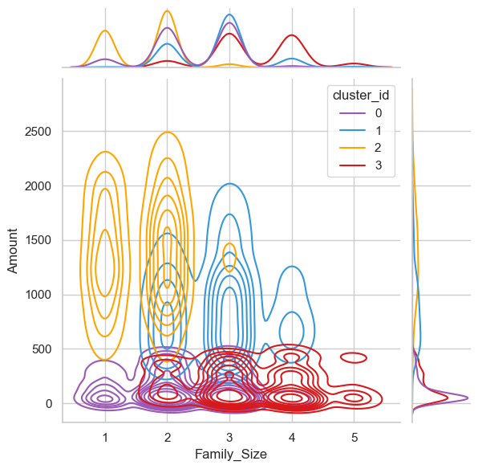

Slide 15
Customer SEGMENTATIon Inferences
Customers who spend more on wines tend to spend more overall.
Frequent customers also make more purchases in physical stores.
Spending on meat items has a strong association with overall spending.
Customers who make more frequent online purchases tend to spend more money overall.
Customers with greater incomes tend to spend more money on fruits and vegetables.
Customers who buy more from catalogues also spend more money on fruits and sweets.
Customers who make more retail purchases are more likely to spend more money on meat goods.
Parents are more likely to visit the website than non-parents.
Customers that embraced the fifth marketing campaign showed a good link with wine spending.
Customers that spend more money can be more open to the fifth marketing campaign.

Slide 16
Cluster analysis
Cluster 0:
The majority of people in this group are parents.
Families in this cluster often have no more than three members.
They often have one child and prefer older children over teenagers.
Customers in this group are often younger.
Low income and low spending.
Cluster 1:
The majority of people in this group are parents.
Families in this cluster often have no more than three members.
They often have one child and prefer older children over teenagers.
Customers in this group are often younger.
Low income and low spending.

Slide 17
Cluster 2:
None of the individuals in this cluster are parents.
Most families in this cluster consist of only two members.
There is a slight majority of couples compared to single individuals.
The age range of customers in this cluster varies widely.
Customers in this cluster have relatively higher incomes and spending habits.
High amount spending & High income.
Cluster 3:
All individuals in this cluster are parents.
Families in this cluster typically consist of a minimum of two members and a maximum of five.
The majority of families in this cluster have teenagers at home.
Customers in this cluster tend to be relatively older.
Low amount spending & average income.

Slide 18
OTHER IMPORTANT INFERENCES FROM CLUSTER ANALYSIS:
So yet, the campaigns have not received a large reaction.
Overall, there were very few participants.
Perhaps more focused and well-planned efforts are needed to increase sales.
Those from Cluster 2 responded the most positively to campaigns, followed by those from Cluster 1.
This client segment provides chances for marketing or commercial tactics to target.
In terms of spending, Cluster 2 is our largest group of consumers, followed by Cluster 1.
We may investigate what each cluster spends on targeted marketing methods.
Cluster 2 represents our most recent collection of consumers.
Cluster 2 and then Cluster 1 are our most active consumers in terms of purchasing.

Slide 19
Business Recommendations Based on Segmentation analysis:
Target Marketing Strategies:
Focus on targeting customers from Cluster 2 and Cluster 1, as they are the biggest sets of customers in terms of spending amount and recency. Tailor marketing campaigns to cater specifically to the preferences and needs of these clusters.
II. Personalized Online Offers:
Since Cluster 2 is the biggest set of customers in terms of recency but not much into deals, consider offering personalized and exclusive online offers to these customers. Utilize data on their past purchases and preferences to provide relevant discounts or incentives to encourage repeat online purchases.
III. Enhance Online Shopping Experience:
Invest in improving the online shopping experience to make it convenient, user-friendly, and visually appealing. Ensure that the website is easy to navigate, and the checkout process is smooth to reduce cart abandonment.

Slide 20
IV. Promote Online-Exclusive Products:
Introduce certain products or product bundles that are exclusively available online. This will create a sense of exclusivity and entice customers from Cluster 2 and Cluster 1 to make online purchases to access these unique offerings.
V. Data-Driven Targeting:
Utilize customer data and analytics to identify trends, preferences, and purchase behavior of online
shoppers. This information can help in creating targeted marketing campaigns that resonate with the
interests of online customers.
VI. Social Media Engagement:
Leverage social media platforms to engage with online customers, showcase products, and run targeted
advertisements.

Slide 21
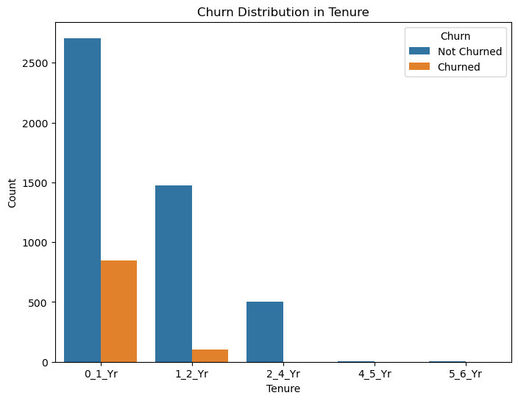
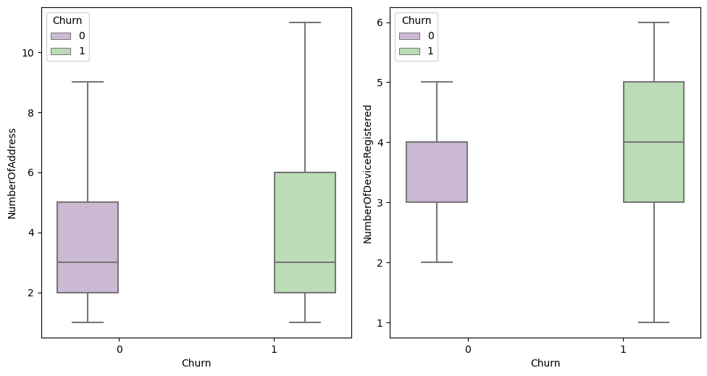
PART- II : CUSTOMER CHURN PREDICTION EDA

Slide 22
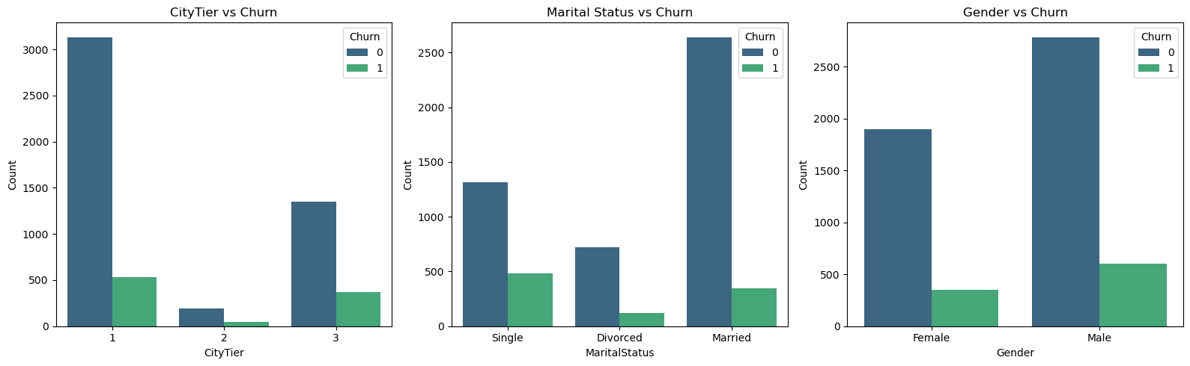

Slide 23
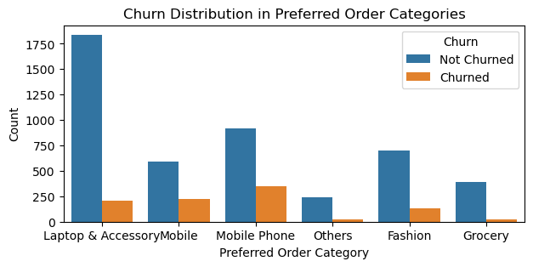
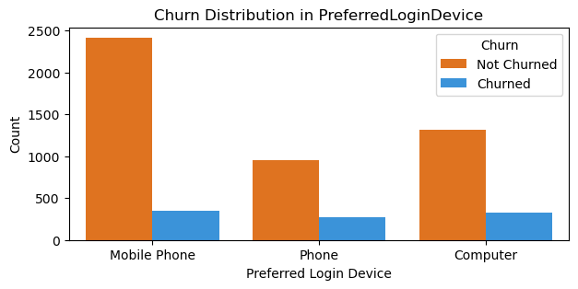

Slide 24
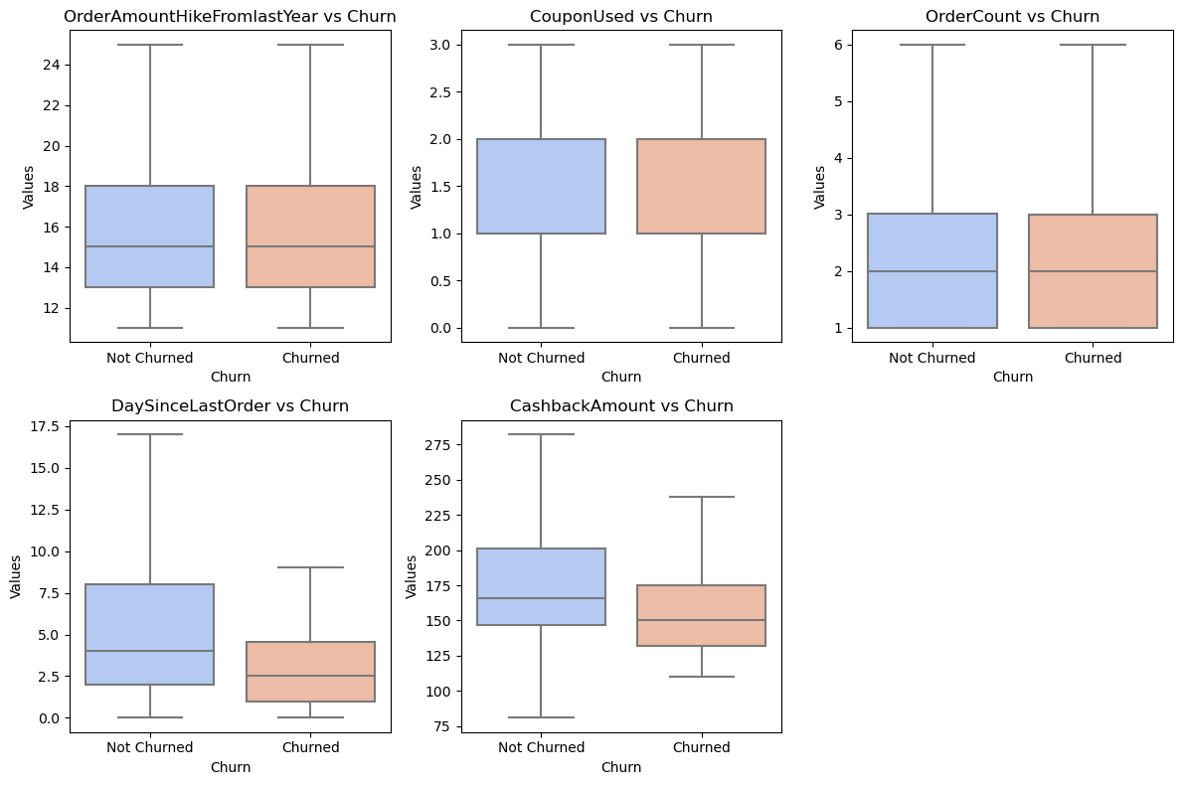

Slide 25
CUSTOMER CHURN PREDICTION INFERENCES
A higher proportion of newly joined clients have a tenure of '0_1_yr’.
The majority of consumers are from CityTier 1.
Mobile phones are the most often utilised customer login devices.
Customers' preferred method of payment is debit cards.
A higher proportion of male clients.
Customers appear to prefer ordering 'Laptop & Accessory' items more frequently.
A higher proportion of married client.
Early tenure bins have a higher churn rate: Customers with tenures of 0 to 2 years are more prone to churn than those with longer tenures. This shows that new consumers, particularly those in their first year of involvement, are more likely to churn. It could be a sign that their onboarding experience or early encounters did not match their expectations or needs.

Slide 26
Decreasing Churn Rate Over Time:
The turnover rate reduces as consumers stay with the company longer. Only non-churn clients after 2 years of tenure shows that once consumers have been with the company for at least two years, their likelihood of churning reduces dramatically. This could be a good sign that clients are becoming more loyal and satisfied with the services over time.
When compared to non-churned customers, a higher proportion of churned customers have more addresses (higher 'NumberOfAddress’).
When compared to non-churned consumers, churned customers have a higher number of registered devices.Customers in CityTier 1 have the lowest churn rate. They are more loyal and are less likely to stop utilising the service or product.
Among various marital statuses, married customers exhibit the lowest probability of churn.
Relationship status Singles have the greatest turnover rate.Male consumers have the lowest churn rate when compared to other genders.
The "Mobile" and "Mobile Phone" categories had higher churn rates. Customers who have chosen these categories as their favourite order category are more likely to churn than customers who have chosen other categories.
Address any product flaws or performance concerns that may be causing consumer displeasure.

Slide 27
Customers who prefer "Computer" and "Phone" for login may have a greater turnover rate than those who prefer "Mobile Phone." This shows that the login device they use may have an impact on their overall pleasure and engagement with the service.
On average, the order quantity increased from the previous year, the coupon used, and the order count do not differ considerably between consumers who churned and those who did not churn.
Significant difference between churn and non-churn consumers in Day since last order. consumers that have not churned tend to make more frequent purchases, whereas churned consumers either make fewer transactions or are more likely to cease buying from the company shortly after their last purchase.
The median cashback amount earned by non-churned customers is more than the median cashback amount obtained by churned customers. This means that, on average, consumers who remain active receive greater cashback rewards than customers who have already churned.

Slide 28
Top 10 Feature:
CashbackAmount
WarehouseToHome
Complain
DaySinceLastOrder
OrderAmountHikeFromlastYear
NumberOfAddress
SatisfactionScore
Tenure_1_2_Yr
OrderCount
NumberOfDeviceRegistered

Slide 29
BUSINESS RECOMMENDATIONS BASED ON CHURN PREDICTION ANALYSIS:
Cashback Offers Optimization:
Consider improving your cashback offers. Analyse client preferences and behaviour to provide personalised and appealing cashback incentives. This can promote client loyalty and drive repeat purchases.
ii. Warehouse-to-Home Delivery Improvements:
Improve the efficiency and dependability of warehouse-to-home deliveries. Faster and more consistent deliveries can improve overall customer happiness and experience, leading to increased conversion rates.
iii. Complaint Management:
customer complaints promptly and effectively .Implement a robust customer support system to resolve issues, improve customer satisfaction, and reduce the likelihood of churn.

Slide 30
Engagement Strategies based on DaySinceLastOrder:
Monitor and optimize customer engagement based on the "DaySinceLastOrder" feature. Implement targeted marketing campaigns, reminders, or personalized offers to re-engage customers who haven't made a purchase in a while.
Identify High-Order Amount Customers:
Analyse customers with significant changes in "OrderAmountHikeFromlastYear." Identify and cater to high-order amount customers with special offers, loyalty programs, or VIP treatment.
vi. Address Customer Needs for Multiple Addresses:
Analyze the impact of "NumberOfAddress" on the target variable. If relevant, optimize your service to accommodate customers with multiple addresses, such as work and home addresses.
vii. Enhance Customer Satisfaction:
Consider ways to improve customer satisfaction .Gather feedback, conduct surveys, and use the data to enhance products, services, and customer interactions.

Slide 31
Viii Retention Strategies for 1-2 Years Tenure Customers:
Target customers with a tenure of 1-2 years for retention strategies. Implement loyalty programs, special offers, or personalized communications to keep them engaged and loyal.
ix. Multi-Device Engagement:
Leverage "NumberOfDeviceRegistered" to improve multi-device engagement. Ensure a seamless and consistent experience across all devices to encourage more frequent interactions and conversions.
x. Promote Repeat Purchases:
Encourage repeat purchases through personalized offers and incentives based on "OrderCount." Implement loyalty rewards or referral programs to motivate customers to make multiple purchases.

Slide 32
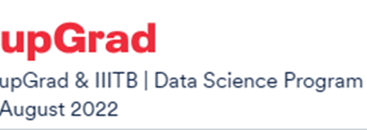
Thank you so much
Ujwal Kesharwani
Shivani Kadam
Amrin Mohammed

